Slide 1
C#
Collections and Generics

Slide 2
Collections
Collections are data structures that holds data of different types for flexible operations.
C# includes specialized classes that store series of values or objects are called collections.
Collections are non generic and generic
The System.Collections namespace contains the non-generic collection types
System.Collections.Generic namespace includes generic collection types.

Slide 3
Non Genric Collection
ArrayList- it will grow dynamically and also shrink . Allows duplicate items
HashTable- Represents a collection of key/value pairs . Any non-null object can be used as a key but a value can be null. Cannot have duplicate keys
SortedList- It uses a key as well as an index to access the items in a list.
Stack- Stack stores the values in LIFO style (Last In First Out). It provides a Push() method to add a value and Pop() & Peek() methods to retrieve values.
Queue- Queue stores the values in FIFO style (First In First Out). It provides an Enqueue() method to add values and a Dequeue() method to retrieve values from the collection

Slide 4
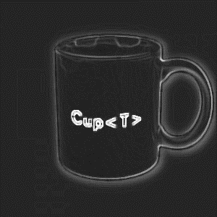
Generics Data Type
Generic Types are Data Types which has place holders for other types to be passed on.
These place holders are referred as Generic Type Parameters
The client code that uses the generic type will provide the value for the placeholder parameter.
For eg, the .NET Framework type System.Collections.Generic.List<T> has one type parameter that by convention is given the name T.
Now Cup is a generic type that is programmed to work with any Type T that is being supplied. T that is
T is a is a placeholder- (Generic Parameter) that can
accept any type supplied
placeholder- (Gy type supplied

Slide 5
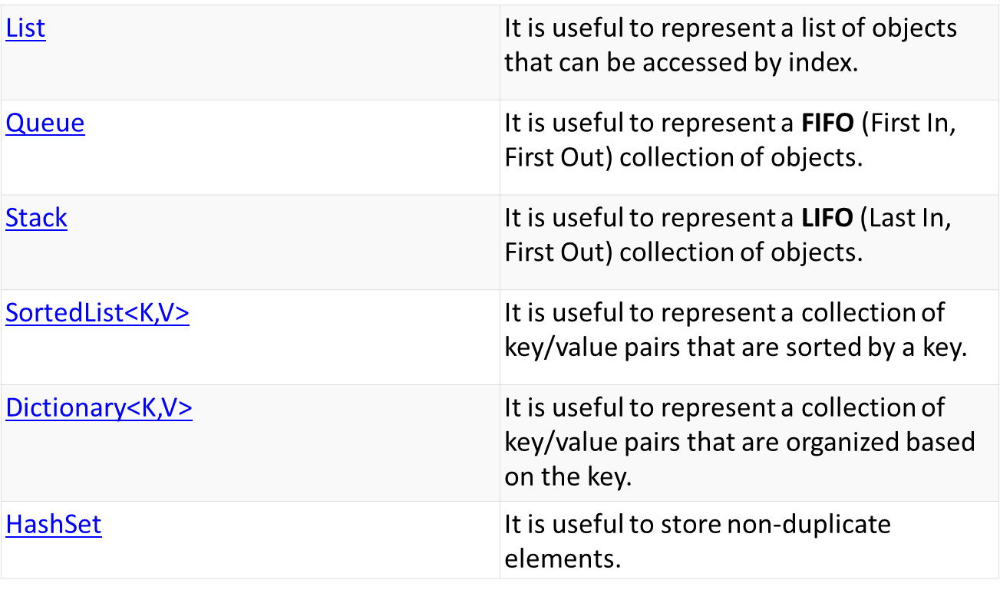
Generic Collections

Slide 6
C#
Exception Handling

Slide 7
Exceptions – Overview
An exception
Is a problem that arises during the execution of a program
provides a way to transfer control from one part of a program to another.
Can be generated by
common language runtime (CLR),
.NET Framework or any third-party libraries
application code.

Slide 8
Exception Class
The Base Class Library provides two types that inherit directly from Exception:
Application.Exception
System.Exception
ApplicationException
Is the base class for all exceptions defined by applications
Exceptions class are derived from Application.Exception class.
Identifies the type of exception
contains properties that have details about the exception
The System.Exception class
Is the base class for all exceptions defined by system
Exceptions class are derived from System.Exception class.
Identifies the type of exception
contains properties that have details about the exception

Slide 9
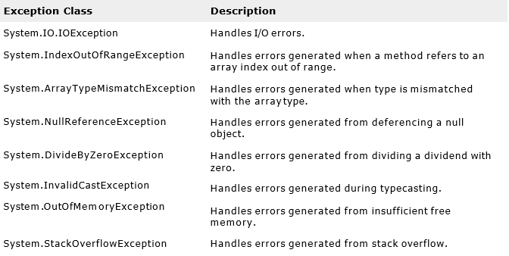
Exception Handling- Inbuilt exceptions
Some of the predefined Exceptions are

Slide 10
Exception Handling
C# exception handling is built upon four keywords:
try,
catch,
finally, and
throw.
try:
A Identifies a block of code for which particular exceptions is activated
catch:
A program catches an exception with an exception handler at the place in a program where you want to handle the problem
finally
The finally block is used to execute a given set of statements, whether an exception is thrown or not thrown.
throw
Throws the exception to the calling method

Slide 11
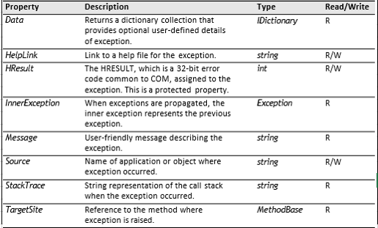
Properties of an Exception Class

Slide 12
C#
File IO

Slide 13
File Input Output Operations
The System.IO namespace Includes many classes which are used to perform input/output operations on Files
The input stream is used for performing Read operation and Output stream is used for performing Write operations
FileReader and FileWriter are components for the file manipulation operation

Slide 14
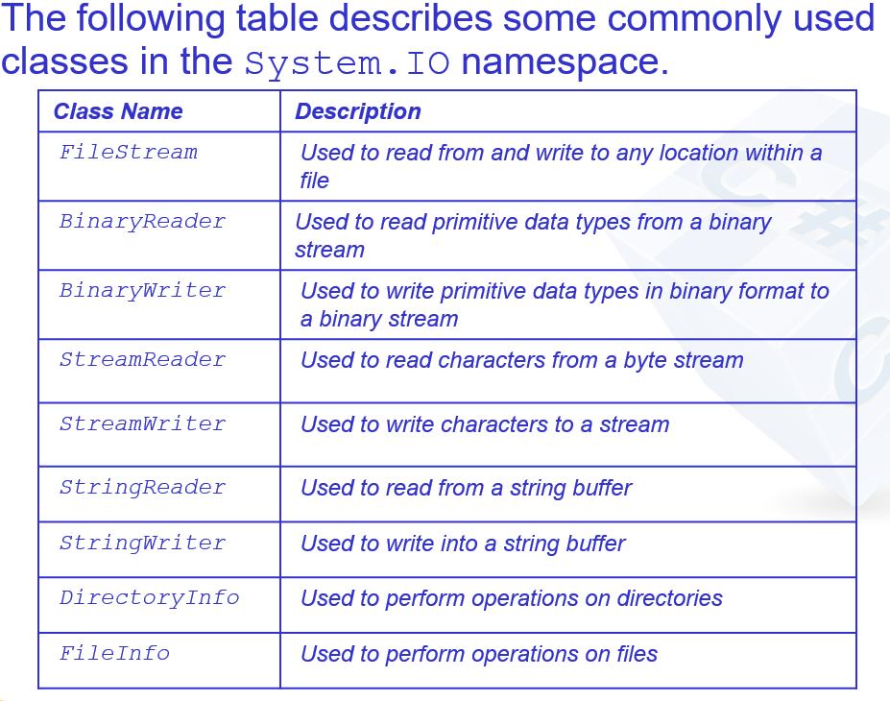
File I/O—(contid…)

Slide 15
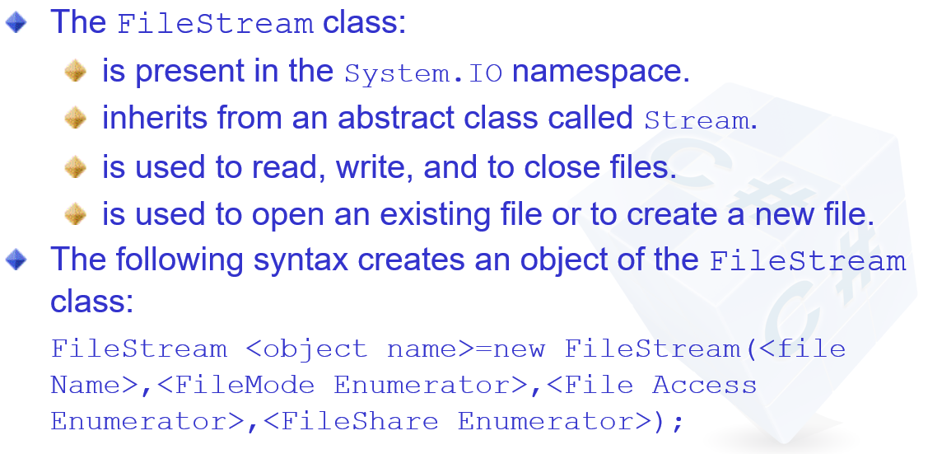
File Stream Class

Slide 16
C#
Threading

Slide 17
Threading: Overview
A thread
Is an independent execution path, which can run simultaneously with other threads.
Share data, if they have a common reference to the same object instance.
C# program starts in a single thread created automatically by the Common Language Runtime and operating system.

Slide 18
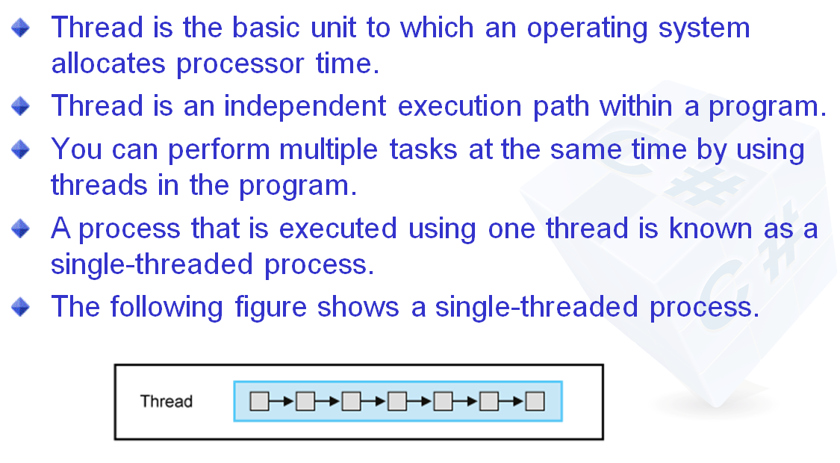
Threading: Overview

Slide 19
How Threading Works
Multithreading is managed internally by a thread scheduler.
On a single-processor computer
a thread scheduler performs time-slicing, rapidly switching execution between each of the active threads.
On a multi-processor computer
multithreading is implemented with a mixture of time-slicing and genuine.
Different threads run code simultaneously on different Central Processing Units (CPUs) which is referred as Concurrency.
DotNet provides Threadpool for better thread management

Slide 20
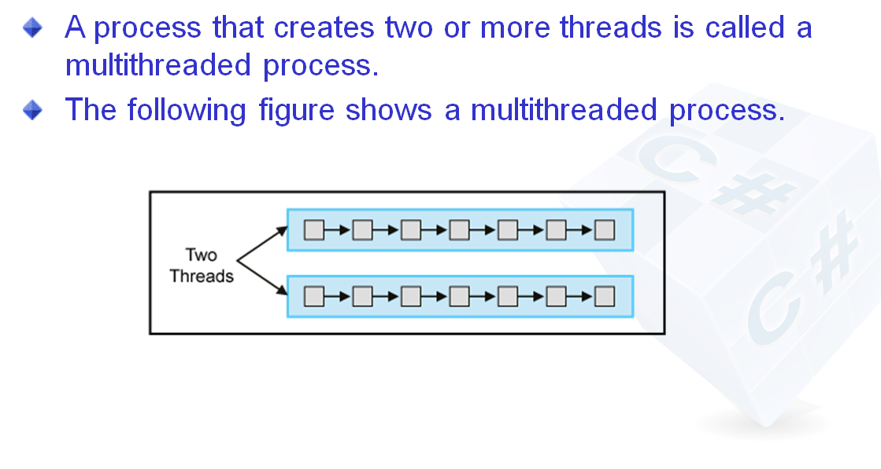

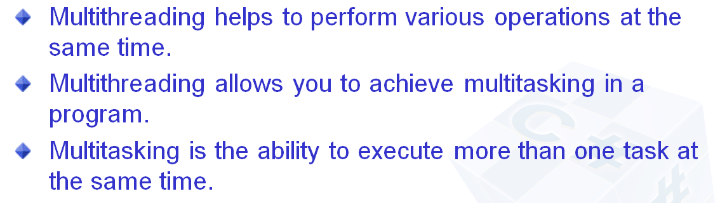
MultiThreading

Slide 21
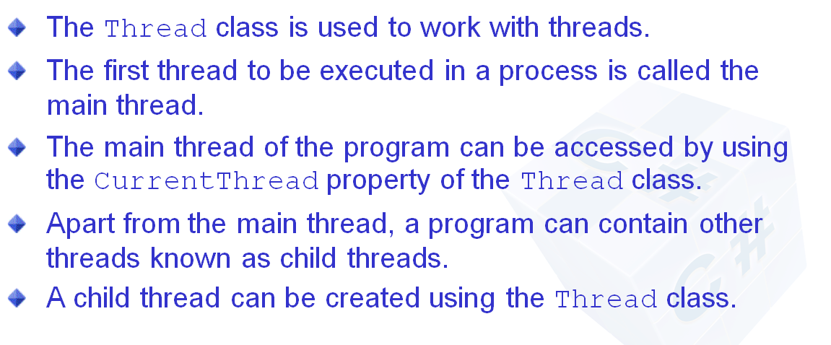
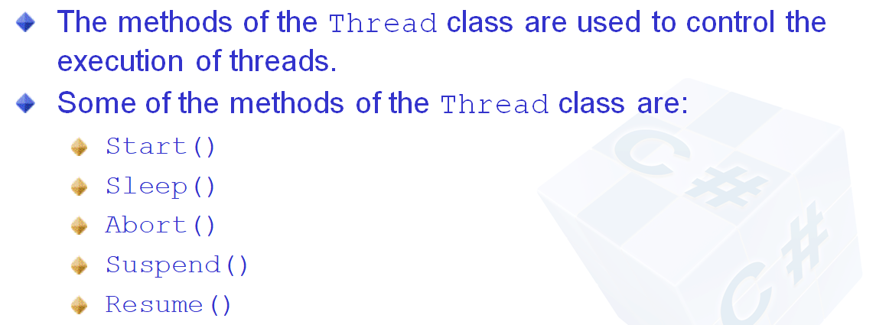
How Threads are created
Specifies the argument index

Slide 22
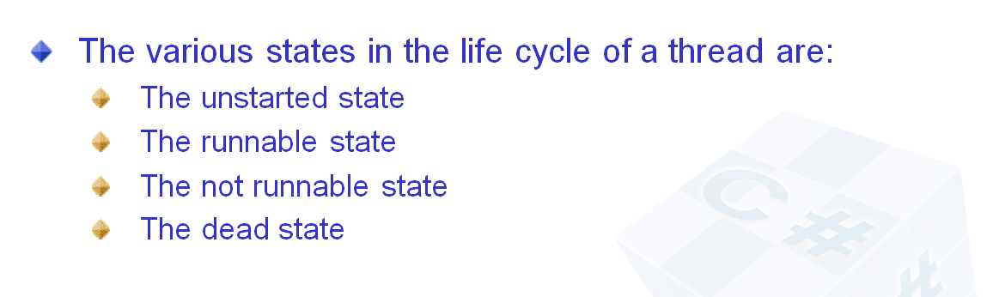
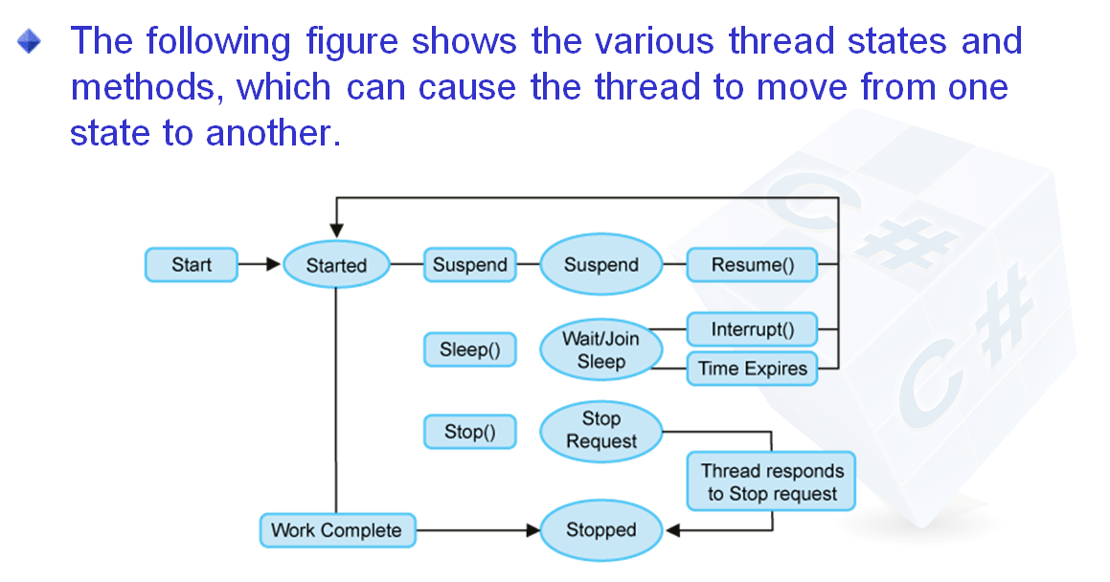
Thread -LifeCycle

Slide 23
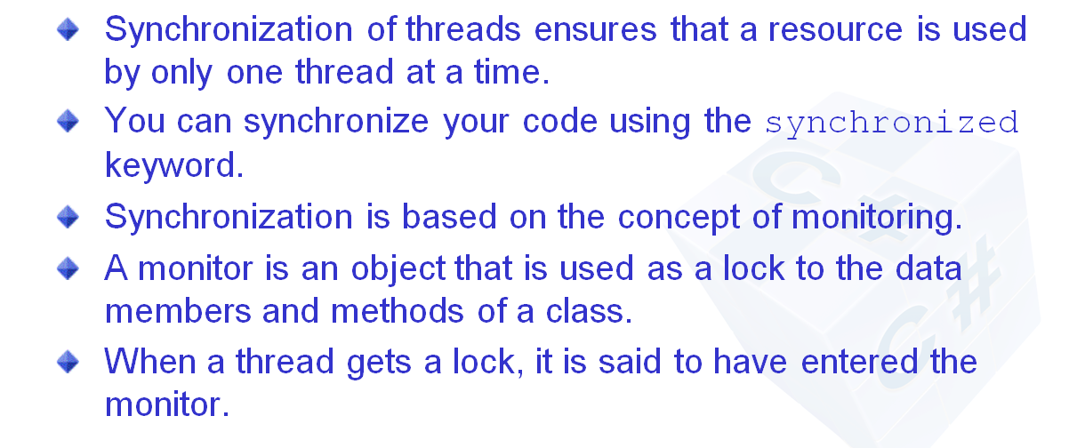
Synchronization of Threads

Slide 24
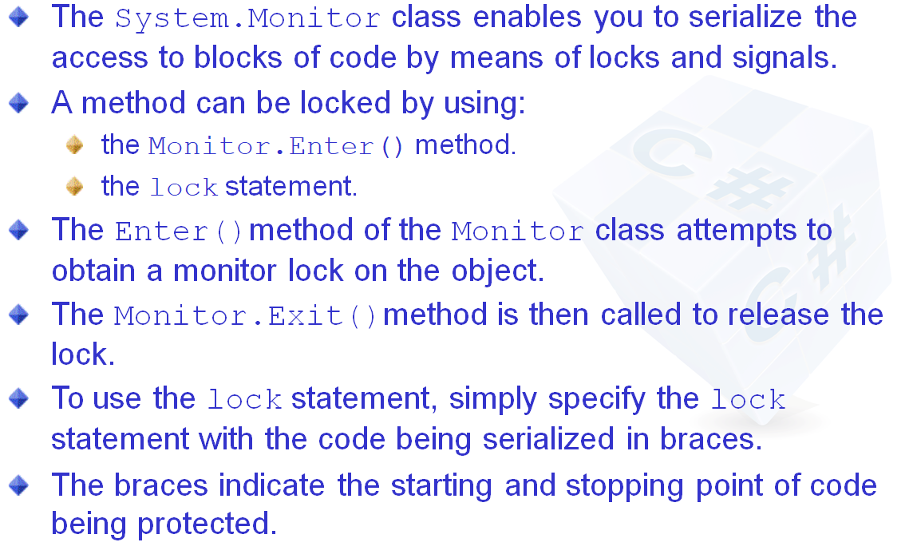
Synchronization of Threads

Slide 25
C#
Delegates

Slide 26
Need of Delegates
Consider a scenario where you need to make a ‘business decision’ in your program. To make a decision you need data .To get data you need to call a method .
When the method name is not known at design time,You need to pass the unknown method as a parameter
The method passing is known as a Callback function
Call back functions are pointers to methods
.NET implements function pointers using delegates

Slide 27
Delegates
A delegate is a reference type variable that holds the reference to a method. The reference can be changed at runtime.
All delegates are implicitly derived from the System.Delegate class.
Delegate declaration determines the methods that can be referenced by the delegate. A delegate can refer to a method, which has the same signature as that of the delegate.Eg:public delegate int MyDelegate (string s);
Syntax for delegate declaration is −delegate <return type> <delegate-name> <parameter list>
You can invoke (or call) the method through the delegate instance.

Slide 28
PreBuild Delegates
The Func delegate takes zero, one or more input parameters, and returns a value (with its out parameter).
Action takes zero, one or more input parameters, but does not return anything.
Predicate is a special kind of Func. It represents a method that contains a set of criteria mostly defined inside an if condition and checks whether the passed parameter meets those criteria or not.
You can invoke (or call) the method through the delegate instance.

